Slide 1


Jorge Rodriguez
11/28/2023

Slide 2

Outline
Executive Summary
Introduction
Methodology
Results
Conclusion
Appendix

Slide 3
Executive Summary
Summary of methodologies
Data Collection from API and Web scraping
Data Wrangling
Exploratory Data Analysis (EDA) with SQL, Pandas and Matplotlib
Interactive Visual Analytics with Folium
Predictive analysis (Classification)
Summary of all results
Interactive analytics
Best performing method using test data

Slide 4
Introduction
Project background and context
Space X advertises Falcon 9 rocket launches on its website with a cost of 62 million dollars; other providers cost upward of 165 million dollars each, much of the savings is because Space X can reuse the first stage. If we can predict what factors determine a successful landing, then we can determine the cost and make better plans for future launches.
Problems you want to find answers
Predict if the first stage of the SpaceX Falcon 9 rocket will land successfully
What factors determine a successful landing

Slide 5

Section 1

Slide 6
Methodology
Executive Summary
Data collection methodology:
Data was collected using SpaceX REST API and web scraping from wiki pages.
Perform data wrangling
One-hot encoding and data cleaning of null values and unnecessary columns
Perform exploratory data analysis (EDA) using visualization and SQL
Perform interactive visual analytics using Folium and Plotly Dash
Perform predictive analysis using classification models
Use machine learning models (LR, KNN, SVM, and DT) to predict a successful landing

Slide 7
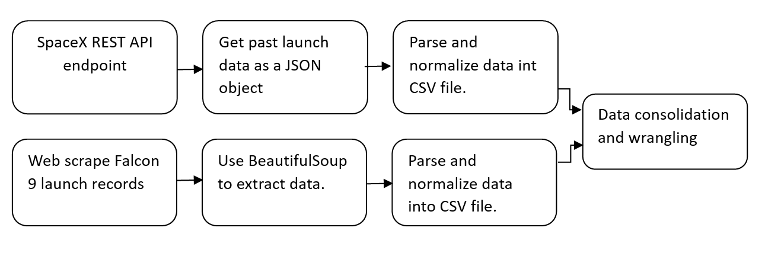
Data Collection
Gather publicly available SpaceX launch data with SpaceX REST API
Scrape data from Wikipedia using BeautifulSoup
Collect data about launches, including rockets used, payload delivery and landing outcome.

Slide 8
Data Collection – SpaceX API
Data collection with SpaceX REST calls
GitHub URL (Data collection)
Place your flowchart of SpaceX API calls here

Slide 9
Data Collection - Scraping
Web Scrapping from Wikipedia
GitHub URL (Web Scrapping)
Place your flowchart of web scraping here

Slide 10
Data Wrangling
Describe how data were processed
You need to present your data wrangling process using key phrases and flowcharts
Add the GitHub URL of your completed data wrangling related notebooks, as an external reference and peer-review purpose

Slide 11
EDA with Data Visualization
Summary of charts created to look for trends:
Scatterplot to see mission outcome relationship between Flight Number and Launch Site.
Scatterplot to see mission outcome relationship between Payload and Launch Site.
Bar chart to see mission outcome relationship with Orbit Type.
Scatterplot to see mission outcome relationship between Flight Number and Orbit Type.
Scatterplot to see mission outcome relationship between Payload and Orbit Type.
Line plot to see mission outcome trend by year.
Add the GitHub URL of your completed EDA with data visualization notebook, as an external reference and peer-review purpose

Slide 12
EDA with SQL
SQL queries performed:
Multiple launch site names with different filtering
Payload Mass by different boosters and mass range
Dates by specific day, year, or date range
Mission Outcomes by payload, date, and location
Add the GitHub URL of your completed EDA with SQL notebook, as an external reference and peer-review purpose

Slide 13
Build an Interactive Map with Folium
Summarize what map objects such as markers, circles, lines, etc. you created and added to a folium map
Explain why you added those objects
Add the GitHub URL of your completed interactive map with Folium map, as an external reference and peer-review purpose

Slide 14
Build a Dashboard with Plotly Dash
Summarize what plots/graphs and interactions you have added to a dashboard
Explain why you added those plots and interactions
Add the GitHub URL of your completed Plotly Dash lab, as an external reference and peer-review purpose

Slide 15
Predictive Analysis (Classification)
Summarize how you built, evaluated, improved, and found the best performing classification model
You need present your model development process using key phrases and flowchart
Add the GitHub URL of your completed predictive analysis lab, as an external reference and peer-review purpose

Slide 16
Results
Exploratory data analysis results
Interactive analytics demo in screenshots
Predictive analysis results

Slide 17

Section 2

Slide 18
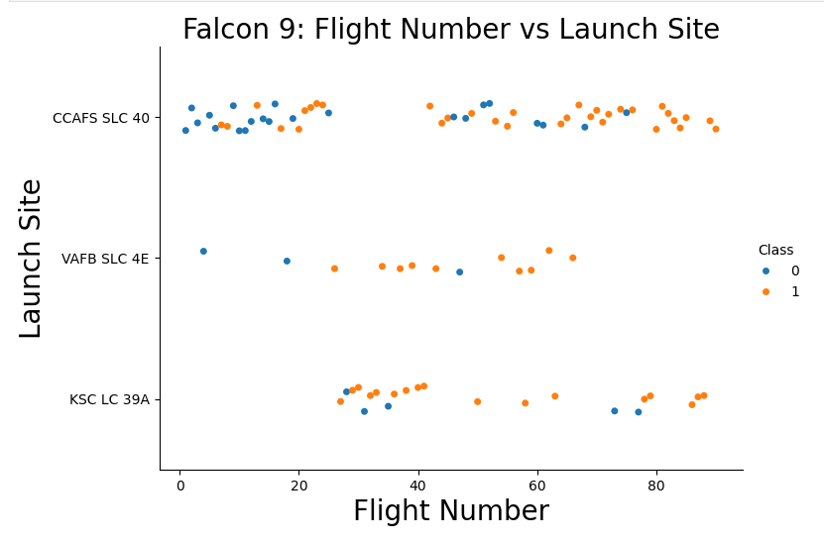
Flight Number vs. Launch Site
Landing success rate varies with launch site.
Successful first stage landings appear to increase as the flight number increase.

Slide 19
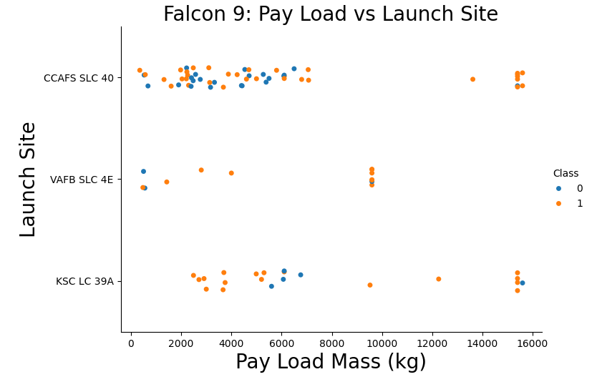
Payload vs. Launch Site
For the CCAFS SLC 40 launch site there doesn’t appear to be any correlation.
Launch site VAFB SLC 4E has high successful landings rate regardless of payload.
KSC LC 39A launch site failed landings are concentrated around the 6,000 kg payload range.

Slide 20
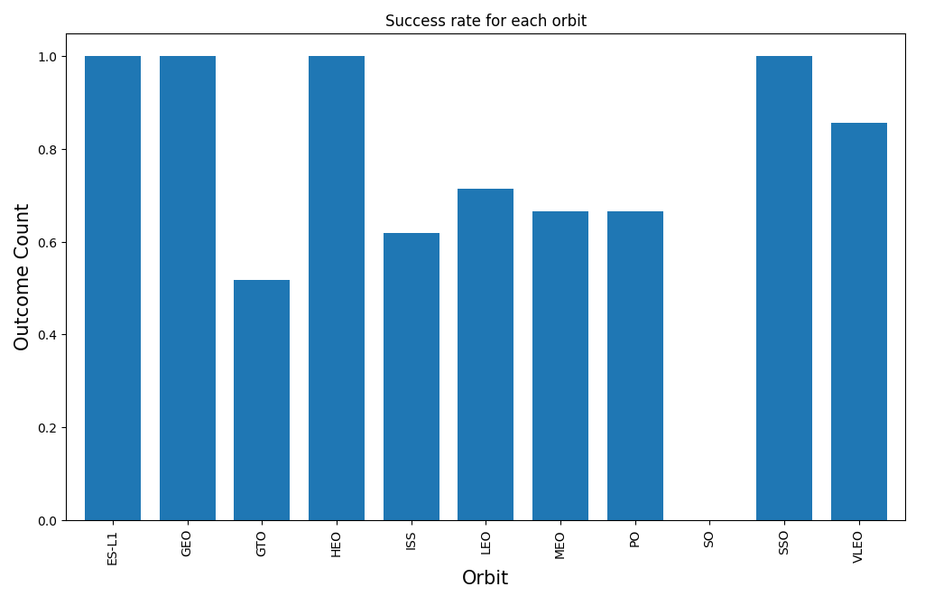
Success Rate vs. Orbit Type
ES-L1, GEO, HEO, and SSO orbits have 100% success rate.
SO orbits have no successful landings.
The remaining orbits have a success rate of between 45% and 65%

Slide 21
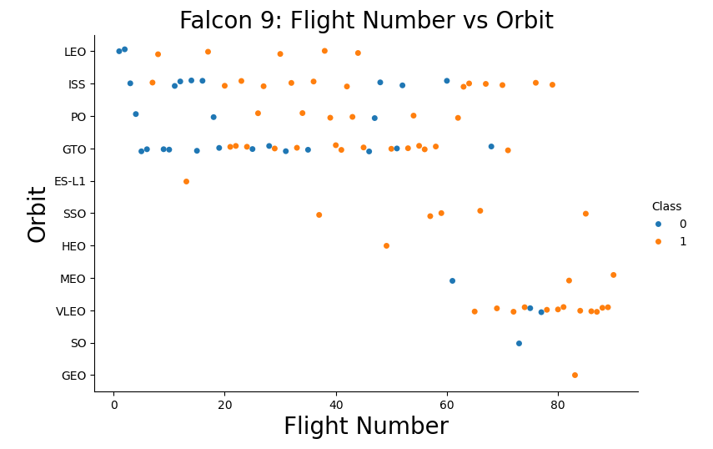
Flight Number vs. Orbit Type
There appears to be a positive correlations between flight number and orbit.
As the number of flights increases, the success rate increases regardless of which orbit type

Slide 22
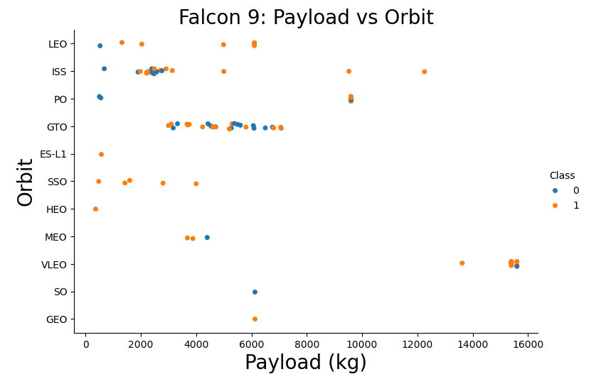
Payload vs. Orbit Type
There is a weak correlation between payload mass and orbit type success rate.
GTO orbit performs the same regardless of payload mass.
LEO, ISS, and PO orbits have a higher success rate with higher payloads.

Slide 23
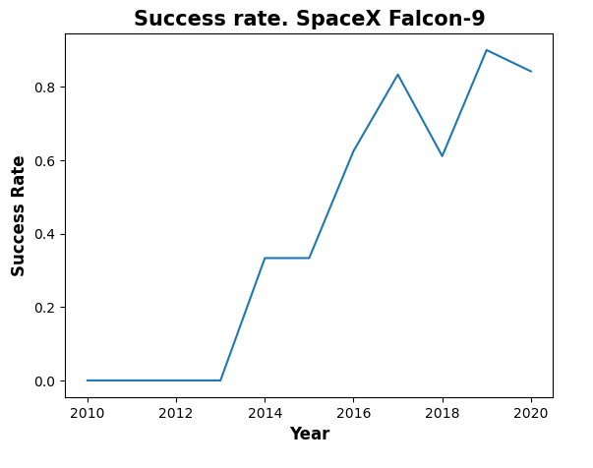
Launch Success Yearly Trend
There is clear positive trend of successful landings over the years.
In recent years, the success rate has remained above 80%.

Slide 24
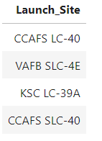
All Launch Site Names
Task: Find the names of the unique launch sites
Query:
Result:
Explanation: List of the four unique launch sites.

Slide 25
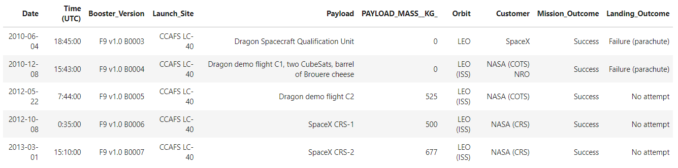
Launch Site Names Begin with 'CCA'
Task: Find 5 records where launch sites begin with `CCA`
Query:
Result:
Explanation: Simple query to become more familiar with the data contained in the database table.

Slide 26
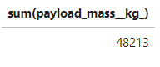
Total Payload Mass
Task: Calculate the total payload carried by boosters from NASA
Query:
Result:
Explanation: The total payload carried by boosters from NASA was 48,213 kg.

Slide 27
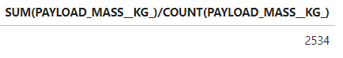
Average Payload Mass by F9 v1.1
Task: Calculate the average payload mass carried by booster version F9 v1.1
Query:
Result:
Explanation: The average payload mass carried by booster version F9 v1.1 was 2,534 kg.

Slide 28
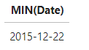
First Successful Ground Landing Date
Task: Find the dates of the first successful landing outcome on ground pad
Query:
Result:
Explanation: The first successful landing outcome on ground pad occurred on Dec. 22nd, 2015

Slide 29
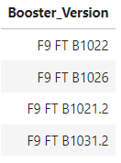
Successful Drone Ship Landing with Payload between 4000 and 6000
Task: List the names of boosters which have successfully landed on drone ship and had payload mass greater than 4000 but less than 6000
Query:
Result:
Explanation: The boosters listed above successfully landed with a payload between 4,000kg and 6,000kg.

Slide 30
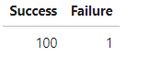
Total Number of Successful and Failure Mission Outcomes
Task: Calculate the total number of successful and failure mission outcomes
Query:
Result:
Explanation: There were 100 successful and 1 failed mission outcomes.

Slide 31
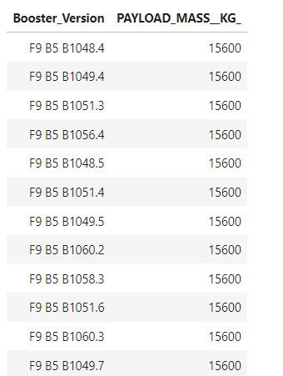
Boosters Carried Maximum Payload
Task: List the names of the booster which have carried the maximum payload mass
Query:
Result: Explanation: Twelve different Falcon 9 boosters carried the max payload of 15,600 kg

Slide 32
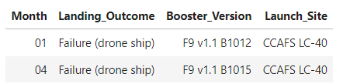
2015 Launch Records
Task: List the failed landing_outcomes in drone ship, their booster versions, and launch site names for in year 2015
Query:
Result:
Explanation: There were two failed landing outcomes in 2015. One in January and the other on April. Both launched from CCAFS LC-40 launch site.

Slide 33
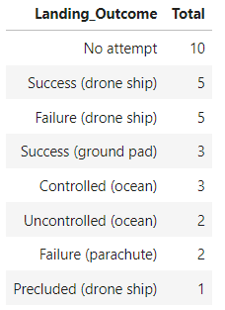
Rank Landing Outcomes Between 2010-06-04 and 2017-03-20
Task: Rank the count of landing outcomes (such as Failure (drone ship) or Success (ground pad)) between the date 2010-06-04 and 2017-03-20, in descending order
Query:
Result:
Explanation: Most common landing outcome was “Not attempted”. Followed by Success (drone ship) and Failure (drone ship)

Slide 34

Section 3

Slide 35
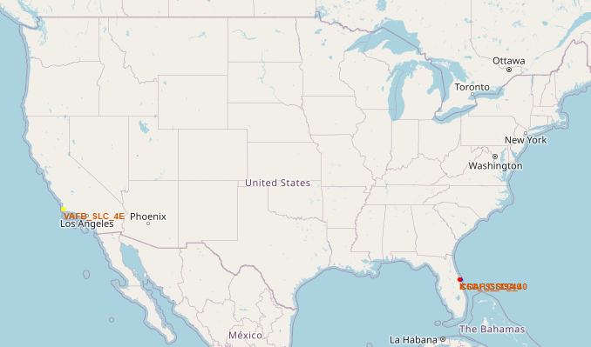
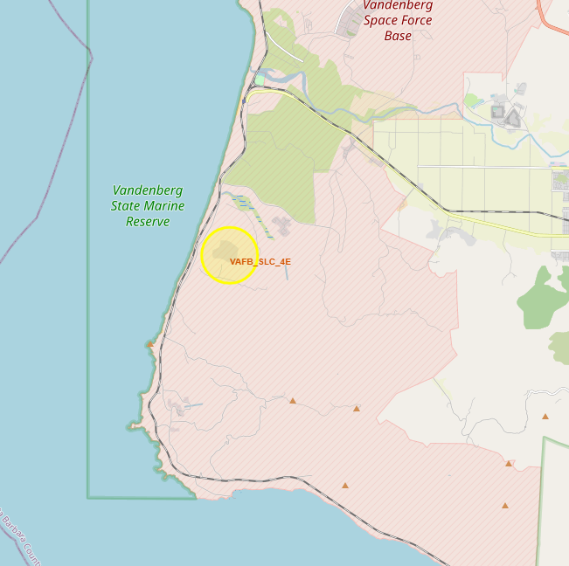
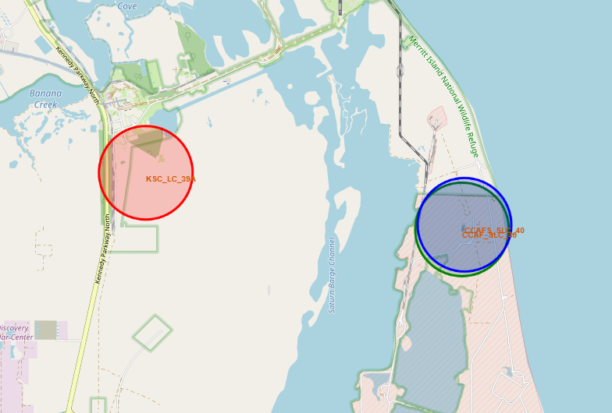
Falcon 9 Launch Site Locations
All launch sites are on the coastline.
All launch sites are on the southern part of the USA. Ideal locations closes to the equator.

Slide 36
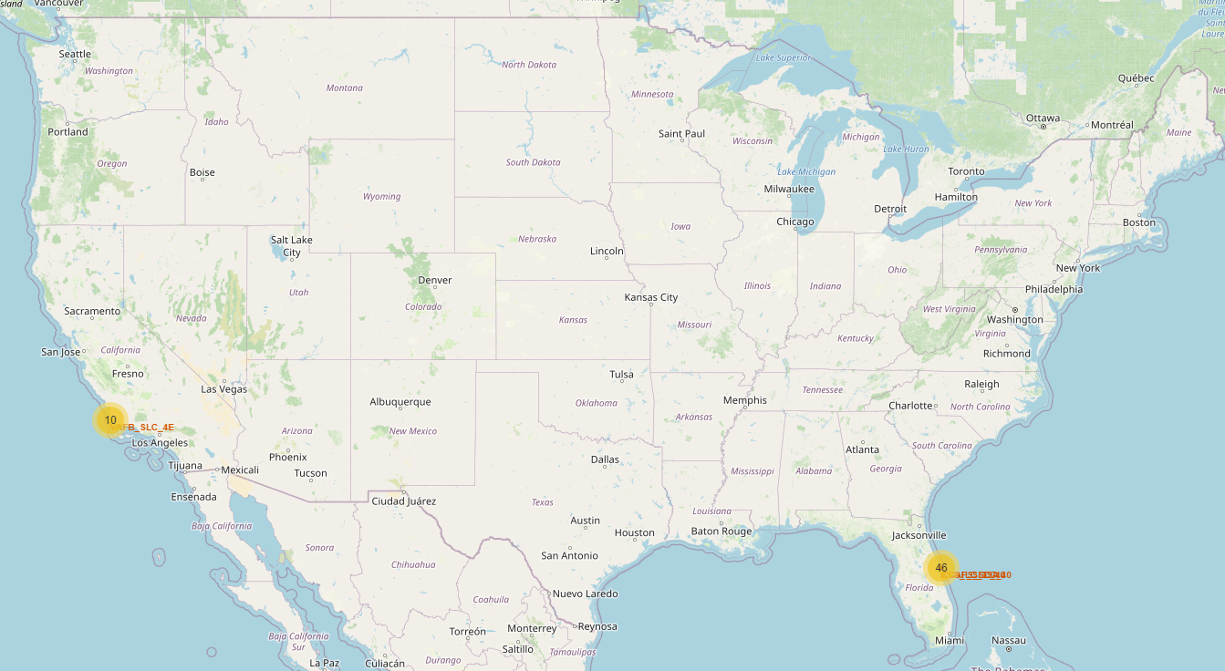
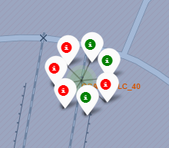
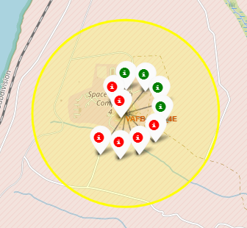
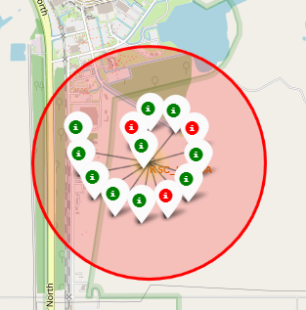
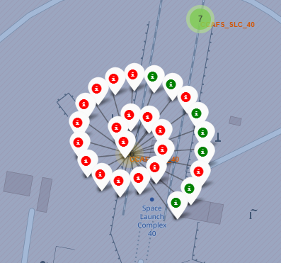
Map Markers of Successful/Failed launches
Green and red markers display successful and failure, respectively, Falcon 9 first stage landings.
The outer ring markers are the most recent flights
CCAFS SLC-40
VAFB SLC-4E
KSC LC-39A
CCAF SLC-40

Slide 37
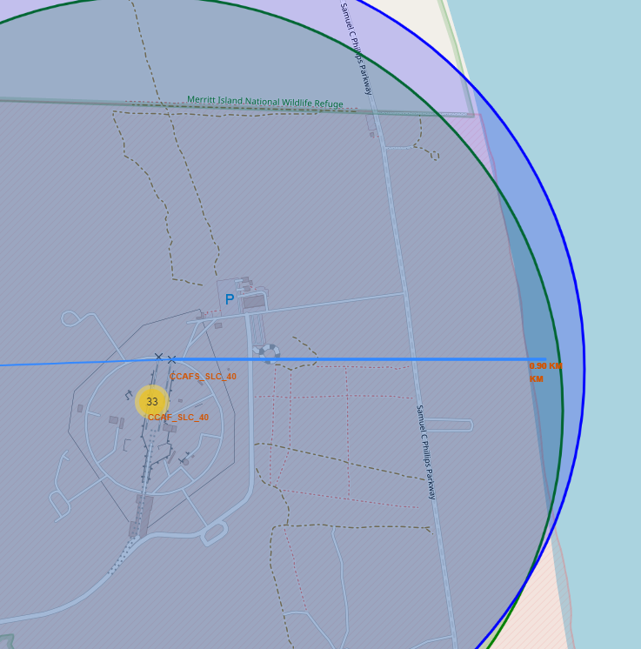
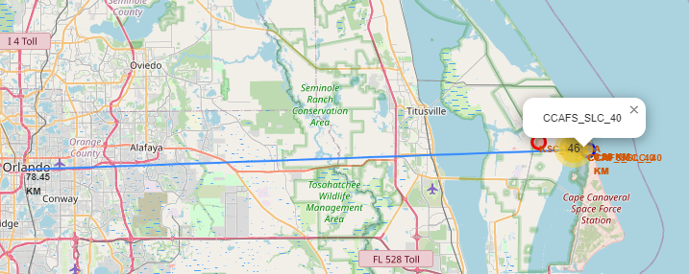
Distance to Proximities
The distance from CCAFS SLC_40 and CCAF SLC-40 to the coastline is approximately 0.9km.
The distance to the closest metropolitan city is 78.45km.

Slide 38

Section 4

Slide 39
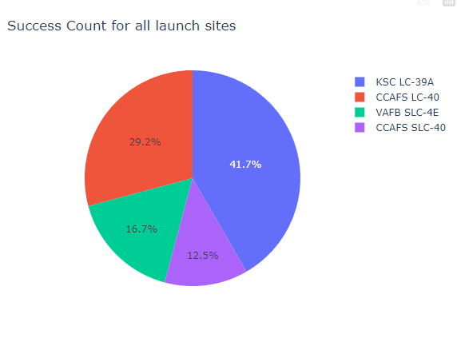
Launch Success Count for All Sites
The pie chart shows the distribution of successful Falcon 9 landings based on different launch sites.
Launch site KSC LC-39A has at least a 10% success rate above all other sites.
Launch sites VAFB SLC-4E and CCAFS SLC-40 combined account for only a third of successful landings.

Slide 40
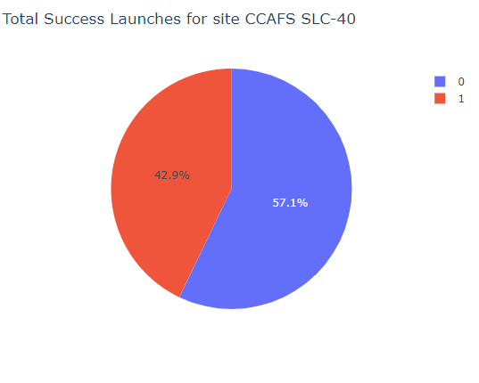
Launch Site with Highest Launch Success Ratio
The pie chart displays failed first stage landings (blue) and successful first stage landings (red)
Launch site CCAFS SLC-40 had the highest success rate (42.9%) among all the sites.

Slide 41
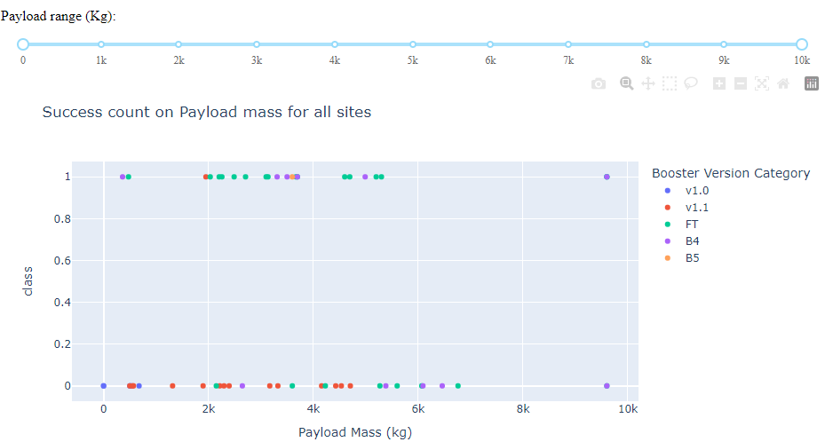
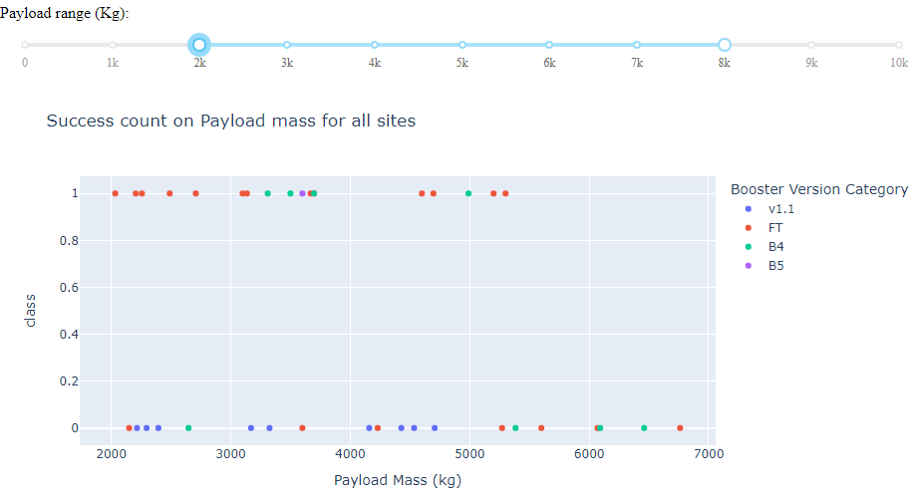
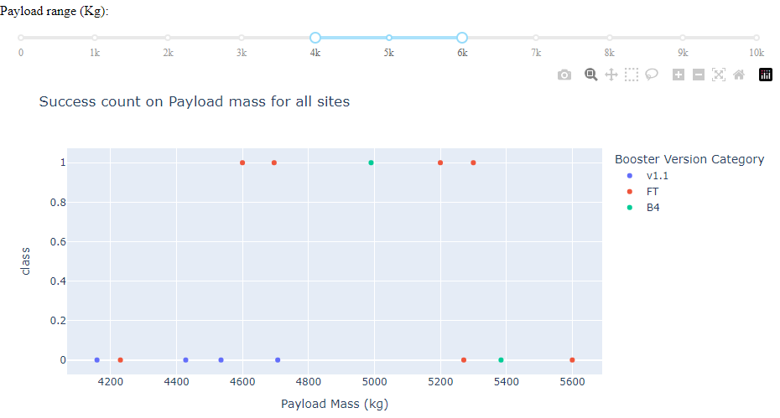
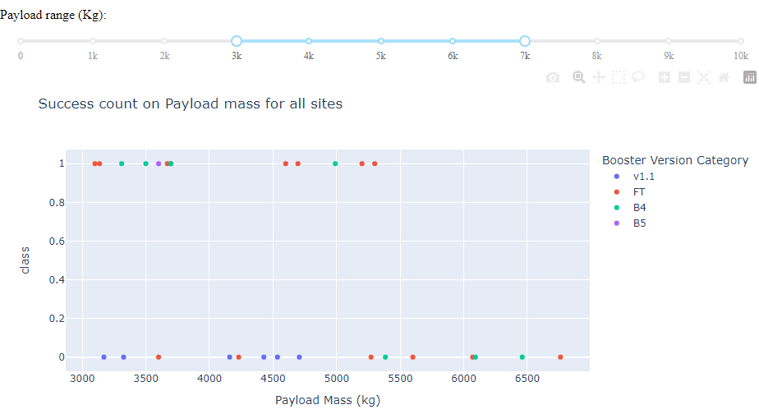
Payload vs Launch Outcome
Booster version B4 and FT are the only ones with a successful landings with payload above 8,000 kg
Payload between 2,000 kg and 5,000 kg seem to be the best range for a successful landing to occur.
Booster version v1.0 and v1.1 only had one successful outcome combined

Slide 42

Section 5

Slide 43
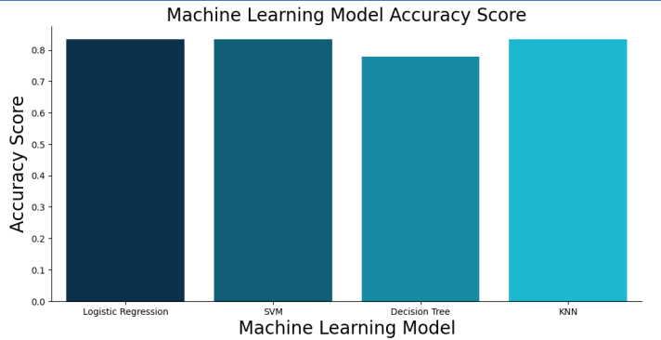
Classification Accuracy
Logistic regression, SVM, and KNN all performed equally well with an accuracy score of 0.84
Decision tree performed the worst of the four models with an accuracy score of 0.75

Slide 44
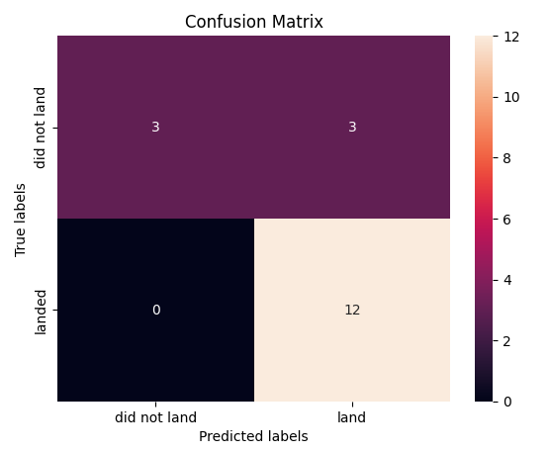
Confusion Matrix of Logistic Regression
LR model confusion matrix show on the right was one of the best performing models.
This model only had 3 wrong classifications (false positve).
15 predictions were correct. 12 true positives and 3 true negatives.
True Negative
False Positive
False Negative
True Positive

Slide 45
Conclusions
SpaceX first stage successful landing outcomes has been trending upwards since the start of the project.
LR, SVM, and KNN models can predict future Falcon 9 first stage outcomes with high accuracy.
As flight numbers increase the rate of success increases possibly because better technology and more data is available to make necessary changes.

Slide 46
Appendix
Include any relevant assets like Python code snippets, SQL queries, charts, Notebook outputs, or data sets that you may have created during this project

Slide 47


